Slide 1
Chapter 5
Timing of Entry

Slide 2
TEACHING OBJECTIVES
1. Explore the trade-offs between early and late entry into an industry.
2. Reinforce the effects increasing returns to adoption has on product diffusion and specify the effects of increasing returns on entry timing.
3. Identify the characteristics of firms that enable them to choose when to enter an industry.

Slide 3

Overview
There are a number of advantages and disadvantages to being a first mover, early follower or late entrant. These categories are defined as follows:
First movers are the first entrants to sell in a new product or service category (“pioneers”)
Early followers are early to market but not first.
Late entrants do not enter the market until the product begins to penetrate the mass market or later.
Notes:
3

Slide 4
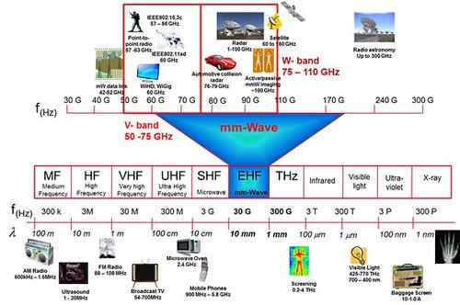
First-Mover Advantages and Disadvantages
Being a first mover can confer the advantages of:
Brand loyalty and technological leadership
Preemption of scarce assets
Exploiting buyer switching costs
Reaping increasing returns advantages.
However, first movers often bear disadvantages also:
High research and development expenses
Undeveloped supply and distribution channels
Immature enabling technologies and complements
Uncertainty of customer requirements
Notes:
4

Slide 5
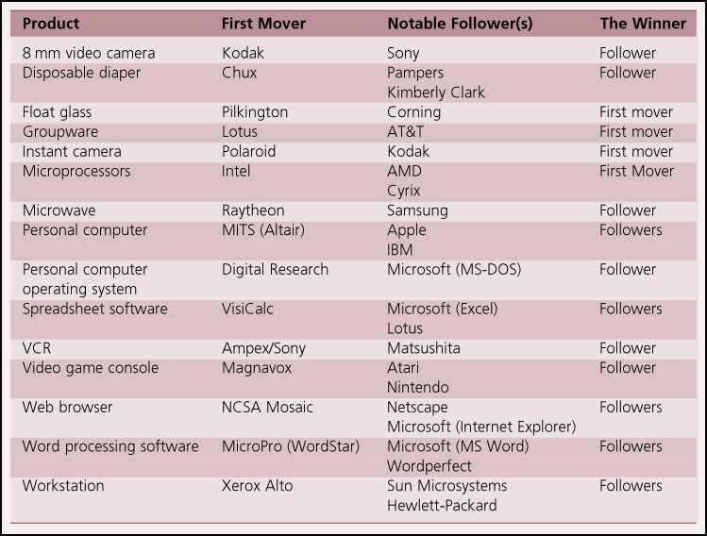
First-Mover Advantages and Disadvantages Continued
The market often perceives first movers as having advantages because it has misperceived who was first.
Notes:
5

Slide 6
Theory In Action
Obstacles to the Hydrogen Economy
Hydrogen offers an inexhaustible and environmentally fuel source that could be used to power automobiles and the electrical grid that serves homes and businesses.
However, several serious obstacles stood in the way of utilizing hydrogen for energy:
Hydrogen vehicles would require a new fueling infrastructure.
Implementing hydrogen as a primary energy source required the cooperation of numerous stakeholders, including government, automakers, oil (or other energy) companies, etc.
Notes:
6

Slide 7
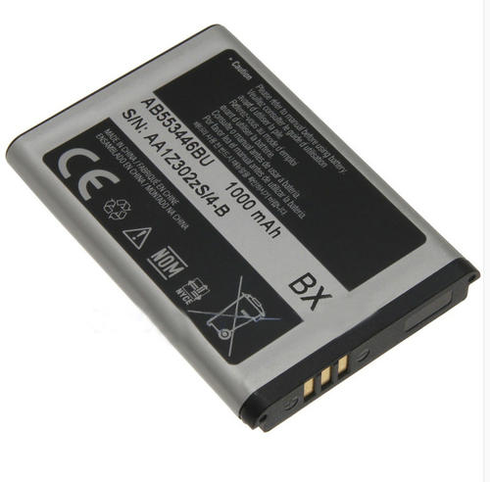
Factors Influencing Optimal Timing of Entry
1. How certain are customer preferences?
If customer needs are well understood, it is more feasible to enter the market earlier.
2. How much improvement does the innovation provide over previous solutions?
An innovation that offers a dramatic improvement over previous generations will accrue more rapid customer acceptance.
3. Does the innovation require enabling technologies, and are these technologies sufficiently mature?
If the innovation requires enabling technologies (such as long-lasting batteries for cell phones), the maturity of these technologies will influence optimal timing of entry.
Notes:
7

Slide 8

4. Do complementary goods influence the value of the innovation, and are they sufficiently available?
Not all innovations require complementary goods, but for those that do (e.g., games for video consoles), availability of complements will influence customer acceptance.
5. How high is the threat of competitive entry?
If there are significant entry barriers, the firm may be less need to rush to market to build increasing returns ahead of others.
6. Are there increasing returns to adoption?
If so, allowing competitors to get a head start can be very risky.
Notes:
8

Slide 9

7. Can the firm withstand early losses?
The first mover bears the bulk of R&D expenses and may endure a significant period without revenues; the earlier a firm enters, the more capital resources it may need.
8. Does the firm have resources to accelerate market acceptance?
Firms with significant capital resources can invest in aggressive marketing and supplier and distributor development, increasing the rate of early adoption.
9. Is the firm’s reputation likely to reduce the uncertainty of customers, suppliers, and distributors?
Innovations from well-respected firms may be adopted more rapidly, enabling earlier successful entry.
Notes:
9

Slide 10
Research Brief
Whether and When to Enter?
Will Mitchell studied 30 years of data on whether and when an incumbent in one subfield of the medical diagnostic imaging industry would enter another subfield. He found:
If only one firm can produce an inimitable good, it can enter if and when it wants.
If several firms could produce a good that will subsequently be inimitable, they race to capture the market.
If good is highly imitable, firms prefer to wait while others invest in developing the market.
Notes:
10

Slide 11
Research Brief Continued
Whether and When to Enter?
He also found:
Firms were more likely to enter if they had specialized assets that would be useful in the new subfield or if their current products were threatened by the new subfield.
Firms entered earlier when their core products were threatened and there were several potential rivals.
Notes:
11

Slide 12
Strategies to Improve Timing Options
A firm with fast-cycle development processes can be both an early entrant, and can quickly refine its innovation in response to customer feedback.
In essence, a firm with very fast-cycle development processes can reap both first- and second-mover advantages.
Notes:
12

Slide 13
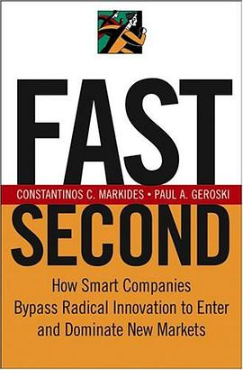
Radical Innovation
Start-up fims
Colonists
Big fims
Consolidators
Fast-second strategy
First-mover strategy ×
Second-mover strategy ×

Slide 14
Discussion Questions
What are some of the advantages of entering a market early? Are there any advantages to entering a market late?
Can you think of an example of a successful a) first mover, b) early follower, and c) late entrant? Can you think of unsuccessful examples of each?
What factors might make some industries harder to pioneer than others? Are there industries in which there is no penalty for late entry?
Notes:
14

Slide 15
From PDAs to Smart Phones: The evolution of an industry
From 1990-1993, a flurry of companies began developing PDAs and analysts predicted millions would be sold by 2004.
However, market confusion and under-developed enabling technologies slowed PDA adoption. Many PDA companies ran out of money by 1994.
The surviving companies included those that specialized in industrial devices, and Palm Computing, which had entered relatively late and produced a streamlined PDA.
By 2003, another storm was on the horizon for the PDA industry: the arrival of smartphones, and much larger competitors such as Nokia, Ericsson, and Samsung, and later Apple.
By 2008, sales of smart phones had reached $39 billion.
Notes:
15

Slide 16
From PDAs to Smart Phones: The evolution of an industry Continued
Discussion Questions:
Why did most of the early PDA companies fail, even if they had innovative and sophisticated product designs?
Could early PDA companies have done anything differently in order to survive?
Why was Palm successful where so many others had failed?
Was being late to the smart phone market a disadvantage for Apple? What factors enabled Apple to successfully enter when it did?
Are there increasing returns in the smart phone market? Is it likely to eventually pick a single operating systems as the dominant design?
Notes:
16

